Slide 1
Secure Data Hiding in Image Using Steganography
AICTE INTERNSHIP PROJECT
Presented By: SHIVAM
Student Name : SHIVAM
College Name & Department : Microtek collage of management and technology, kerakat, jaunpur

Slide 2
OUTLINE
Problem Statement
Technology used
Wow factor
End users
Result
Conclusion
Git-hub Link
Future scope

Slide 3
Problem Statement
In the modern digital world, data security and privacy are major concerns.
Traditional encryption techniques can raise suspicion when intercepted.
Steganography allows secure data hiding within images, making it less detectable.
This project implements image-based steganography using efficient algorithms.

Slide 4
Technology used
Programming Language: Python
Libraries Used:
OpenCV (Image Processing)
NumPy (Data Handling)
Stegano (Steganography Implementation)
Platform: Windows/Linux

Slide 5
Wow factors
Enables covert communication without suspicion.
Maintains image quality while embedding hidden messages.
Extracts hidden data accurately without major loss.
Works on multiple image formats (JPEG, PNG, etc.).

Slide 6
End users
Cybersecurity Professionals: Secure message transmission.
Journalists & Activists: Hidden communication in sensitive areas.
Digital Forensics Experts: Watermarking and data security.
Government & Defense: Covert intelligence and secure information sharing.

Slide 7
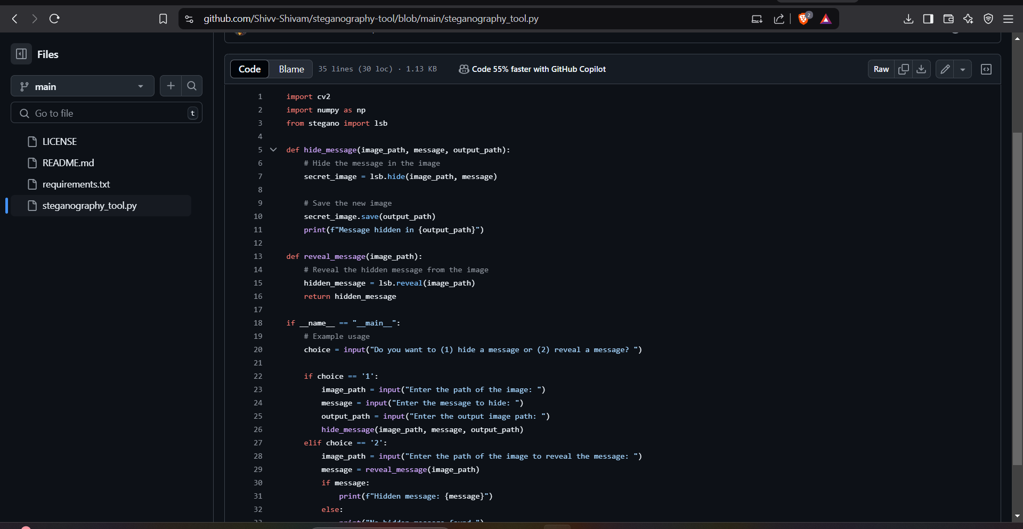
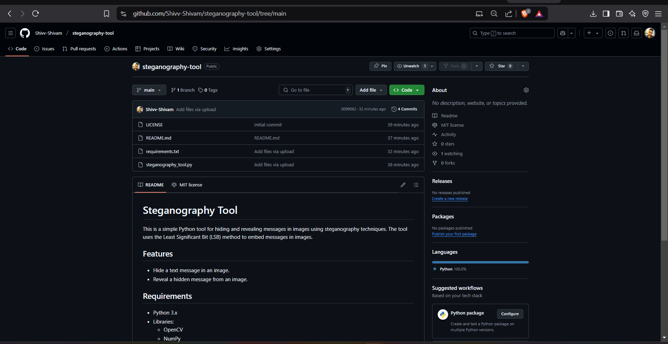
Results

Slide 8
Conclusion
Steganography provides a secure method to hide and transmit data.
Least Significant Bit (LSB) technique ensures minimal distortion.
Can be enhanced using encryption for additional security.

Slide 9
GitHub Link
https://github.com/Shivv-Shivam/steganography-tool/tree/main
https://github.com/Shivv-Shivam/steganography-tool.git

Slide 10
Future scope(optional)
Integration with AI to detect steganography-resistant images.
Use of blockchain for authentication and security.
Development of a mobile-based steganography application.
Enhancements to prevent detection using steganalysis techniques.

Slide 11
THANK YOU

